Slide 1
Domain Adaptation
Michal Baránek

Slide 2
What is domain adaptation
Form of transfer learning with access to target domain data
Allows us to use knowledge from source domain
Useful when target domain has only unlabelled data

Slide 3


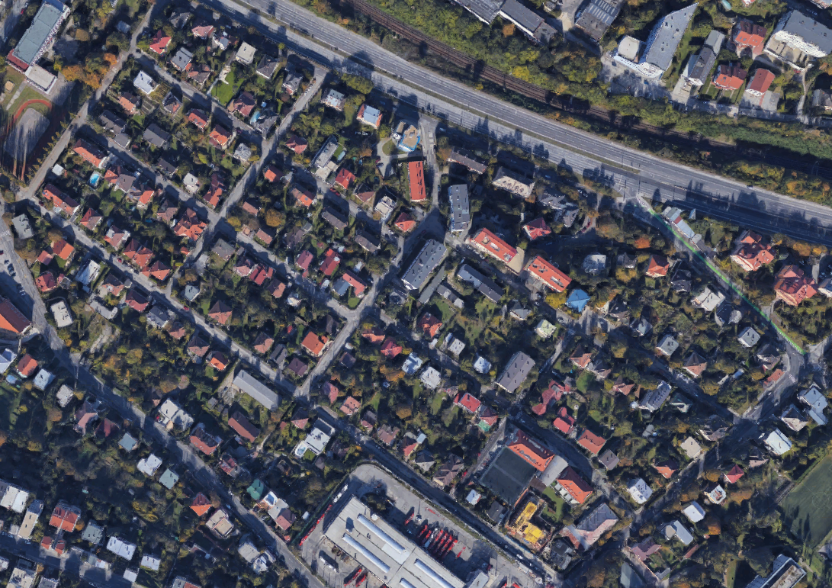
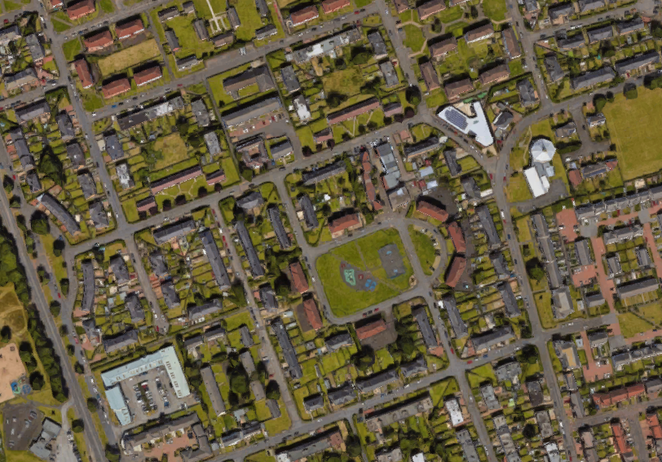
Common assumptions of domain adaptation
Source and target domain differ only in domain
There exists a single hypothesis with low error

Slide 4
Domain adaptation approaches
Importance sampling
Feature alignment
Domain translation

Slide 5
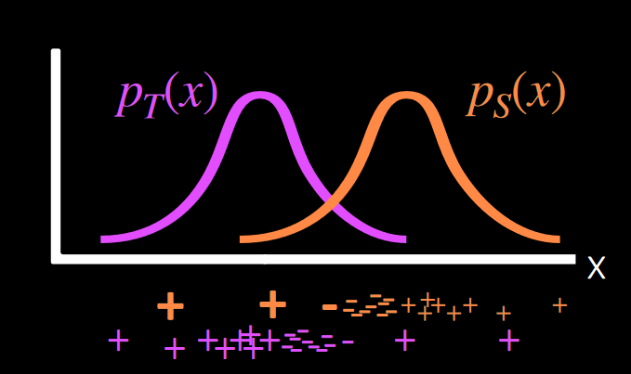
Importance sampling
Simple
Effective
Requires source distribution to cover target
Very specific scenarios
Uses Empirical risk minimization
Solution
Finding a ratio
Reweighing data points
Low source, high target -> upweight
High source, low target -> downweight
Notes:
Classifier, ktorý je natrénovaný na source moc nerieši – nevšíma si oblasť, kde je má target peak.
Príklad – nejaký language detection na Wiki a potom arXiv, nemocnice by nefungovali pretože tie obrázky by boli natoľko rôzne, že by to nebolo dobré

Slide 6
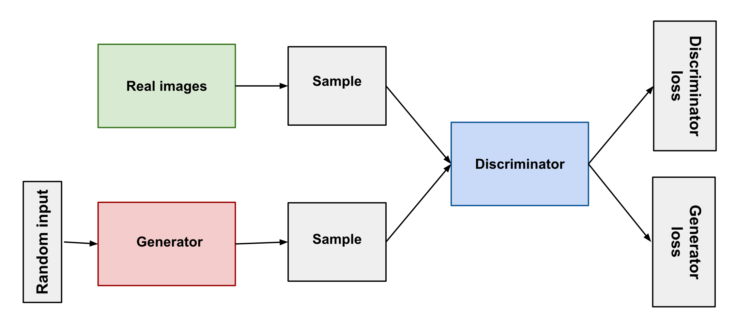
GAN (Generative adversarial network)

Slide 7
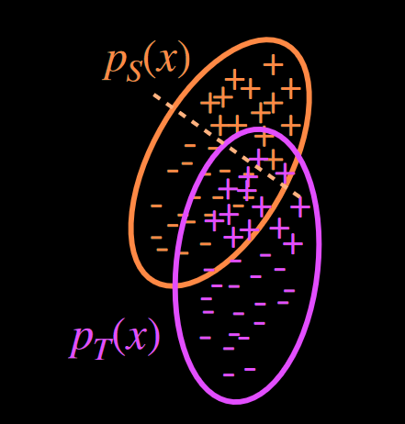
Feature alignment
Still rather simple
Doesn‘t need source coverage
Uses adversarial optimization (Domain confusion)
Matching features at population-level
Notes:
Population – level – matchovanie na úrovni skupín, nie jednotlivých dát (čísla)
Použitie discriminatoru a classifieru, zero sum game
Adversial training – GANs, optimize for 50/50

Slide 8
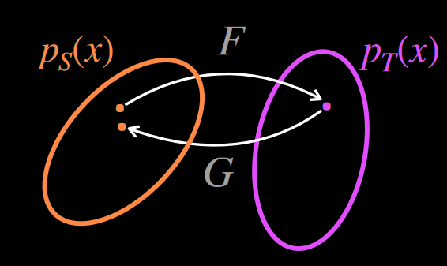
Domain translation
Harder to create
Easier to debug
Uses GANs
Image generators
Trying to create a bijection between generators
Helpful when distributions match

